Slide 1
Qualtrics What Is It And How Do I Use It?
Patrick Rossmann
Teri Schnelle
Division of Student Life
Notes:
Both; Intros

Slide 2
Zoom Etiquette
We are all learning!
Be Aware:
If your mic is on
If you are muted
If your video is on
Who is in the background
If you are sharing your screen, share just the program you want to share
Don’t record without permission
Other thoughts?
Notes:
Teri

Slide 3
Outcomes
As a result of this workshop, participants will be able to:
Explain the pros and cons of using Qualtrics Survey software as an assessment tool
Construct a survey using Qualtrics
Notes:
Teri
Very broad view and feel free to login on to Qualtrics too to follow along

Slide 4
Qualtrics
Qualtrics is a web-based survey and data collection tool for creating and conducting online surveys.
It can be used to conduct research, departmental surveys, academic surveys, etc.
This tool is available at no charge to all faculty, staff and students at The University of Iowa.
https://its.uiowa.edu/qualtrics (Login with HawkID and password)
Notes:
Teri

Slide 5
Uses for Qualtrics
Surveys
Applications
Registrations
Others?
Notes:
Teri
As mentioned earlier time, money, and energy are limited so it is important to assess what is important. Having a clear purpose will ensure your survey provides data that will help you answer your questions and make decisions. It is also easy to start asking questions about things you’d like to know versus asking what you need to know. Keeping your purpose in mind will help you ask only essential questions.
Organization conducting the survey; Purpose of the survey; Value of participating; Confidentiality or anonymity of the survey
As you develop the questions ask yourself the following:
Will the questions provide the data you need to answer your questions or make decisions?
Are all the questions consistent with the objectives of the survey i.e. are there redundant, irrelevant, or unnecessary questions?
How will the data be used? Develop an action plan for utilizing the data.
Are the questions clear?
What should the question sequence be i.e. introductory questions, grouping related questions, using filtering questions, etc.
Limit survey length (Surveys should be as concise as possible while still meeting the objectives of the survey. Online surveys should take respondents less than 15 minutes to complete)

Slide 6
Qualtrics
Notes:
Teri

Slide 7
Create a Project
New
From a copy
Notes:
Teri

Slide 8
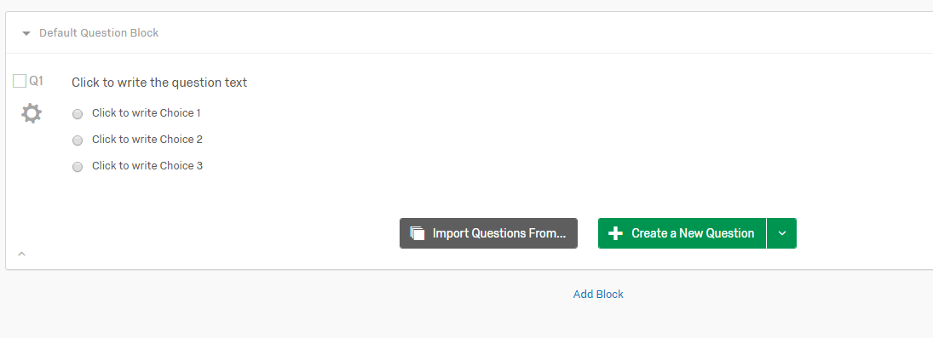
Survey: Questions
Adding questions
New questions
Importing questions
Notes:
Teri

Slide 9
Survey: Questions
Changing survey questions
Notes:
Teri

Slide 10
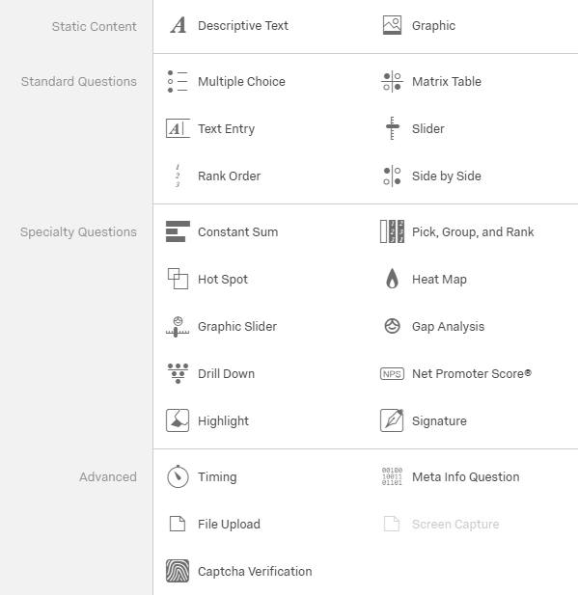
Survey: Question Type
Question type
Static content
Standard questions
Specialty questions
Advanced
Notes:
Teri

Slide 11
Survey: Question Type
Uploading Documents
Notes:
Teri

Slide 12
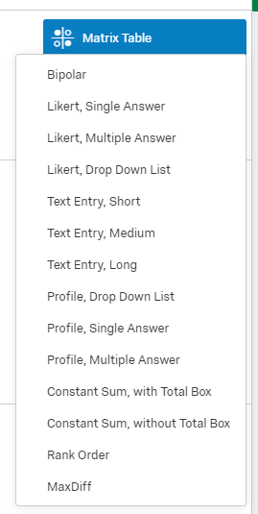
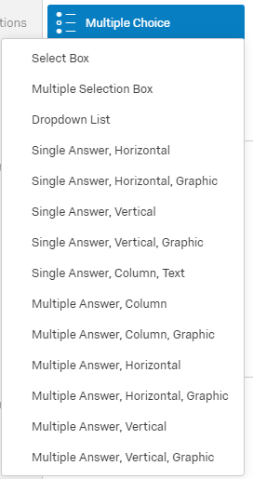
Survey: Additional Options
Additional options for survey questions
Notes:
Teri

Slide 13
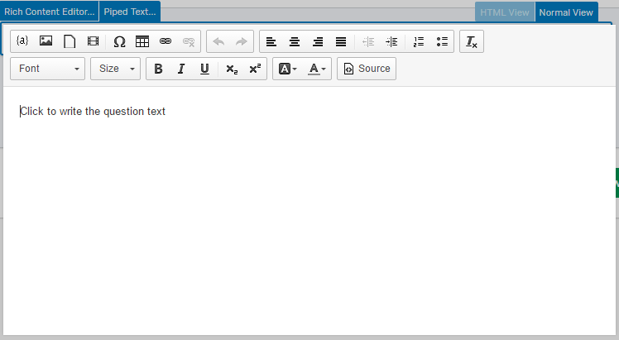
Survey: Additional Options
Rich Content Editor
Notes:
Teri

Slide 14
Survey: Additional Options
Notes:
Teri

Slide 15
Survey: Display Logic
Ideal for conditionally displaying answer choices or single questions.
Notes:
Teri

Slide 16
Survey: Skip Logic
Allows you to send respondents to a future point in the survey based on how they answer a question.
Notes:
Teri

Slide 17
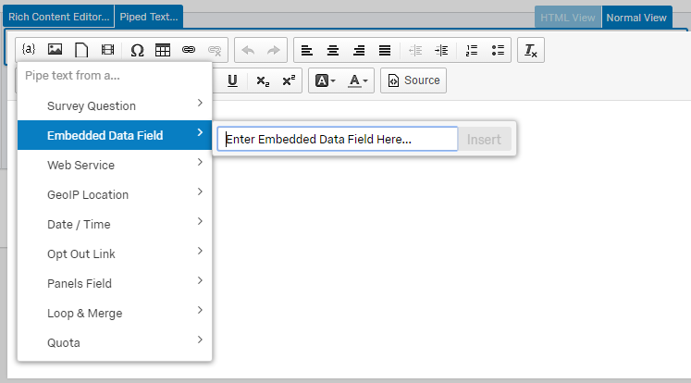
Survey: Pipe Text
Survey question
Embedded data
Notes:
Teri

Slide 18
Survey: Preview Survey
Look and feel
Logic
Notes:
Teri

Slide 19
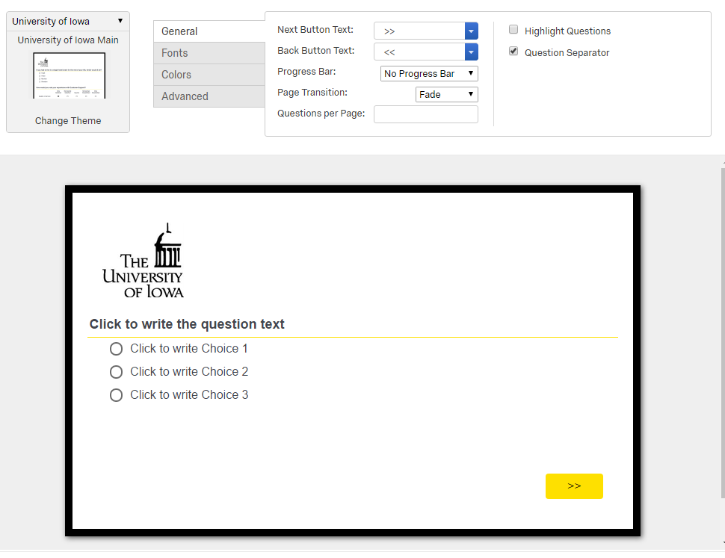
Look & Feel
Notes:
Teri

Slide 20
Survey Flow
Notes:
Teri

Slide 21
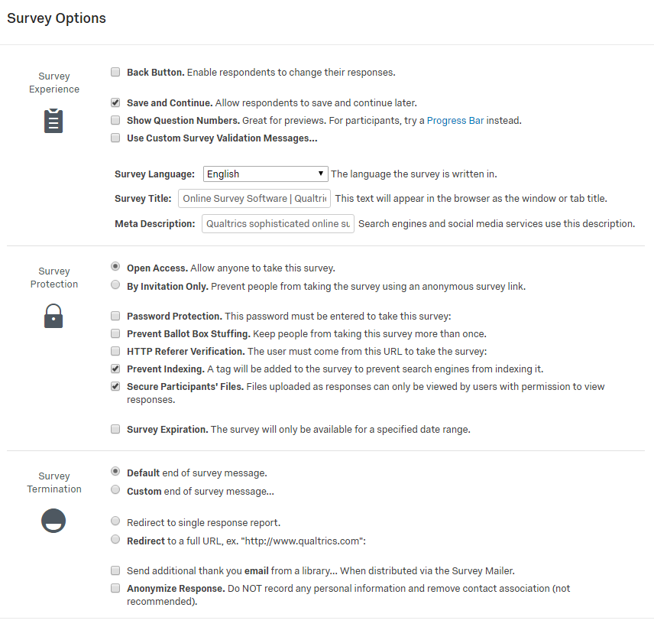
Survey Options
Notes:
Teri

Slide 22
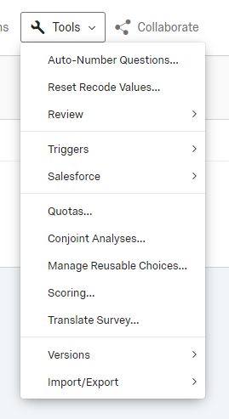
Tools
Export Survey
Triggers
Quotas
Notes:
Patrick

Slide 23
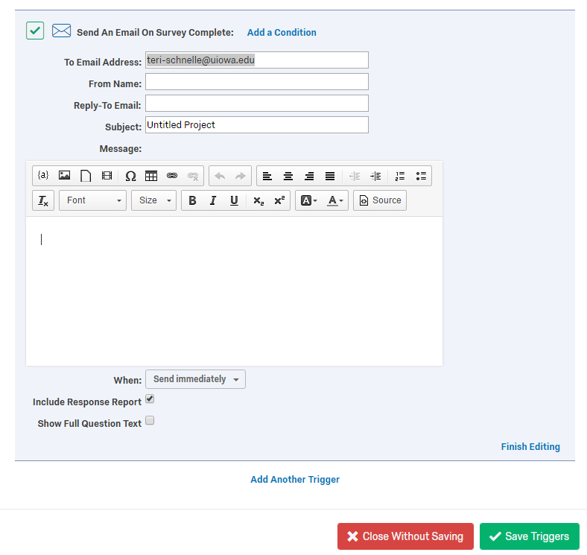
Tools: Email Triggers
Allow you to send an email notification to someone when a survey response is completed and specified conditions are met.
You can set up multiple triggers (for respondent and surveyor)
Notes:
Patrick
Similar to mail merge and can customize based on their responses
Useful when you want to have an email confirmation for the respondent
Useful when you may not check the responses very often and want to know when a new survey is completed
Not useful to get a notification if you’re expecting many responses in a short period of time
When and why would you use this? This can be useful for giving the responder confirmation that they filled out the survey. It also might be helpful to send the person administering the survey to get a notification that someone new filled it out, instead of logging into Qualtrics to see if there’s any new responses.
Example: Light therapy check out/check in. With the light therapy check out, we have them fill out their information, but I want them to have a “receipt” that they check it out that includes a due date for return as well more information about how to use the light box. A student worker also gets an email so that she can then update our tracking spreadsheet.
How would you use this?
At the survey, click on tools, and go to triggers and select “Email Triggers…” You can then fill out the conditions of what gets sent and to whom. You can set up multiple triggers to go to multiple people.

Slide 24
Tools: Quotas
Allow you to:
Keep track of how many respondents meet a condition in your survey
Specify what will happen to your respondents once a quota has been met, such as ending the survey prematurely or deleting the extra responses
Notes:
Patrick
Useful for registration so you don’t exceed a set number. You can also set up quotas for specific questions. For example, you want volunteers to sign up for multiple time slots. You can close certain times when full, but keep open available times.

Slide 25
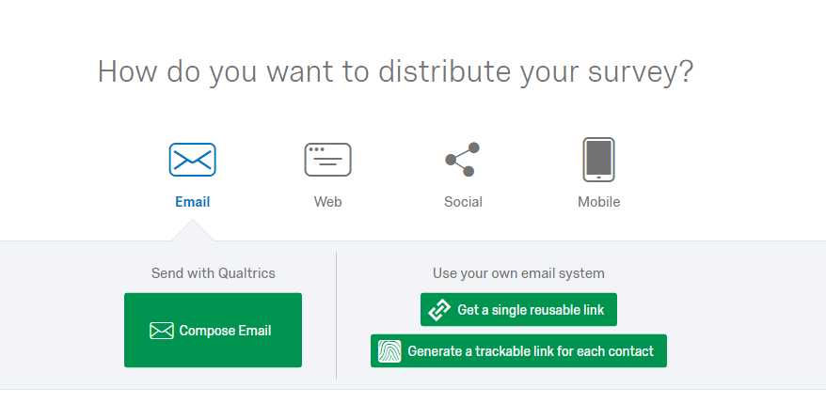
Distributions
Reusable link
Email contact list (panel)
Notes:
Patrick

Slide 26
Email Contact List
Compose Email from Survey Distribution (you can save this)
Set up Contact List with email addresses (you can save this too)
Each person gets an individualized link (important to know if they completed it or not)
You can set this up in advance to send at a later date
Notes:
Patrick
When would you use this? When you’re sending to a set group of people and have their individual email addresses. It’s not just an open anonymous link.
Why would you use this? There are many advantages to doing this. You can personalize the message to the person (similar to mail merge). You can set it up in advance and have it ready to go. It creates an individualized link so you know if it was filled out or not and can follow up with just the people who haven’t responded. (we’ll talk about this more later). You can link survey response to individual data (this is a little more complicated, but essentially if you already knew the person’s demographic information, you wouldn’t need to ask again).
Example: In SW, we send out a 3-month follow-up survey. I have a list of students that I can set up in advance that goes directly to them.
How would you use this?
Let’s assume you’ve already created the survey you want to send out.
Then, go to the survey you want to send. And go to distribution. Instead of anonymous link, you’ll want to click on the Email. From there you’ll click on the Compose Email button, which brings you to an email screen where you write your email. If it’s an survey you’ll be sending again and again you can save your email as a template to make it easy to resend.
For the “To” field, you can select contacts. Either make a new contact list or use a contact list from your library. Essentially, upload all the emails and save it.
You can decide when it goes out and schedule in advance of just have it go out then.
When you send it, each person gets an individualized link.

Slide 27
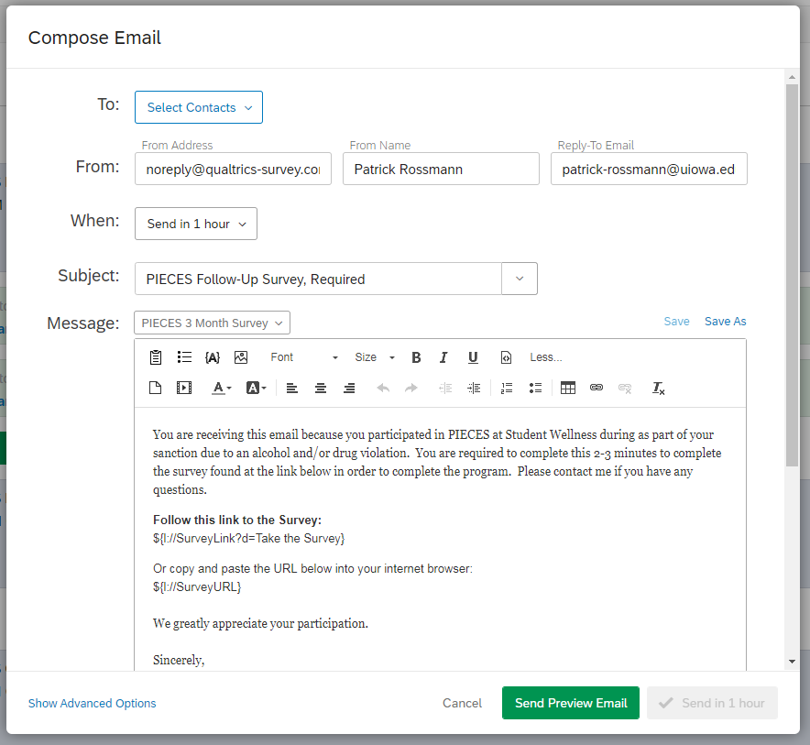
Notes:
Patrick

Slide 28
Reminders to incomplete respondents
If you send the survey through Qualtrics, you can easily follow up ton ONLY those that have not completed the survey
In this In this example, 25 emails were sent on Feb. 1. On Feb. 4th, an email reminder went out to 17 unfinished respondents (only 8 completed it the first time). On Feb. 10th it went out to 7 unfinished people (10 completed this time). Overall, 22/25 finished the survey (another 7). That’s an 88% response rate!
Notes:
Patrick
When would you use this? When you want to reach out to only those who have not completed the survey.
Why would you use this? This way you only send a reminder to people who have not completed the survey. You’re not sending it to everyone and starting your email with, “for those that haven’t completed the survey.” You don’t have people fill out the survey multiple times because they forgot if they did it or not. You get a much higher response rate, and can easily send multiple reminders. incomplete
Example: SW 3-month follow-up survey.
How would you use this? You’ve already set up a survey to go out via email. It’s really easy to add a reminder. It’s building on the survey email you already sent. Just click on the schedule reminder button and set it to go to “unfinished respondents”. Qualtrics knows who has filled it out or not. You can schedule it in advance (e.g. one week after the first email went out). You can edit the email message to acknowledge that it’s a reminder. You can also set up multiple reminders (I generally stop at 3, because then it gets annoying). You can also schedule a thank you response if that’s of interest.

Slide 29
Linking to another survey (Anonymous Raffle)
You want to incentivize people to respond, but you want to keep answers anonymous
Set up your main survey
At the end of this survey, make a multiple choice question asking if they would like to enter a raffle
Create a second survey for entering the raffle
Copy the single reusable link
Create a condition if they want to enter the raffle to take them to the second link
Notes:
Patrick
https://www.qualtrics.com/support/survey-platform/common-use-cases-rc/creating-an-anonymized-raffle/

Slide 30
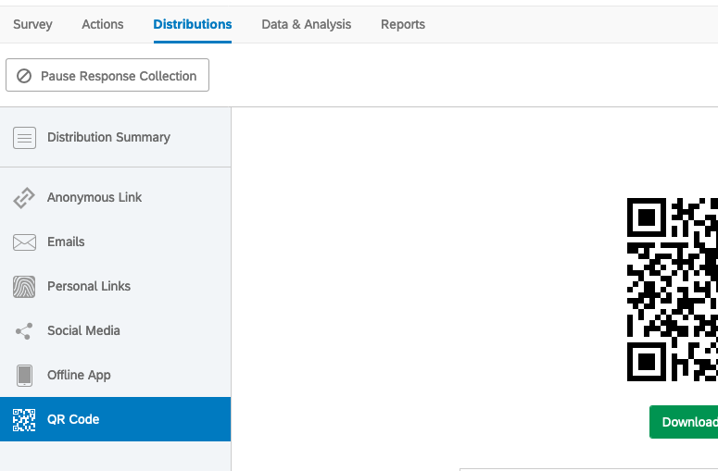
QR Codes
Easy to set up and can be useful when you want people to complete the survey on their phone in the moment
Notes:
Patrick

Slide 31
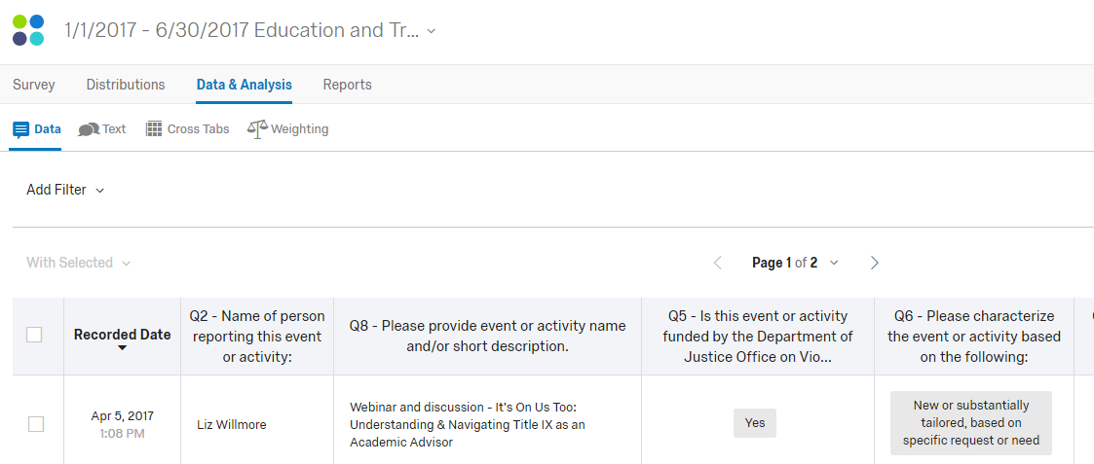
Data & Analysis
View specific responses
Export the data
Notes:
Teri
Can use Iowa GROW Student Employee Survey as an example.

Slide 32
Reports
Visualizations
Filters
Export
Notes:
Teri

Slide 33
Questions?
Notes:
Both of us
Qualtrics is more than just a simple survey too, and you can make your surveys better with the tools we shared.
How are they using it?
How do they want to use it?
Things they are struggling with

