Slide 2
Introductions
In groups of 2-3 share your name, department, student employee supervision, and what you are hoping to gain from today’s session.

Slide 3
Agenda
Enhancing student success through employment and the key role of supervisors
Overview of Iowa GROW® initiative and outcomes
Iowa GROW® conversation tips and resources

Slide 4
Goals of IOWA GROW®
To make student employment a high-impact activity by providing structured opportunities for students to reflect on and integrate what they are learning
To help students better articulate what they have learned from their job

Slide 5
Guided Reflection on Work
    Iowa GROW® uses brief, structured conversations between student employees and their supervisors to help make the learning that is occurring through student employment more “visible” to the students.
    The conversations focus on 4 key questions about what students are learning and how they are applying their learning.
      How is this job fitting in with your academics?
      What are you learning here that’s helping you in school?
      What are you learning in class that you can apply here at work?
      Can you give me a couple of examples of things you’ve learned here that you think you’ll use in your chosen profession?
Notes:
Nationally recognized intervention

Slide 6

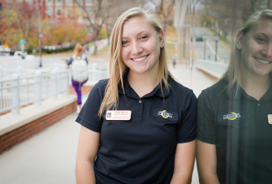
What does IOWA GROW® involve?
Two brief, structured conversations per semester
Guided by the 4 questions. We offer additional questions you can use over time.
Conversations can be 1:1 or small group (as many as 8 students)
An average conversation takes 5 minutes
“Not only does GROW illustrate the power of simple reflective practices, but it also underscores how small interventions can have significant outcomes for the undergraduate experience.”
-Felten, et al (2016)

Slide 7
What is high-impact?
Kuh: Students are most successful in “seamless environments” where they can make connections between classroom and out of classroom experiences
High-impact activities are those that allow students to apply learning to real-life, to make connections, to reflect and to integrate learning.
Campus jobs can be high-impact for our students with some additional structure from us (supervisors).

Slide 8
Making employment high-impact
Identified outcomes (what we want them to know or be able to do)
Deliberate reflection
“Scaffolding” — using prompts that encourage students to connect previous knowledge and experience to new experiences and knowledge

Slide 9
Specialists in student employment
Typically, student affairs and academic student services are the largest employers of students. We can be leaders in high-impact student employment.
To do this, we must reframe student employment from transactional to transformational, from supervision to mentoring, from cost to investment.

Slide 10
Supervisors’ role
Supervisors are educators.
As supervisors, you help students learn real-world skills.
Many supervisors are already having conversations with their student employees.
Through Iowa GROW® supervisors can help make even deeper connections between work and academics.

Slide 11
IOWA GROW® Outcomes
  Division of Student Life Student Employment Survey is conducted every spring.
  Spring 2017 Survey – 714 responses (38% response rate).
  Iowa GROW ® participants were determined based on their answer to the following question:
    “How often during the spring semester have you had conversations with your supervisor about connections between your job and your academics? Your supervisor may refer to these as IOWA GROW conversations”

Slide 12
  IOWA GROW® participants were significantly more likely (p<.01) to agree/strongly agree that their job was helping them attain the following 10 outcomes of student employment:
1
My supervisor helps me make connections between my work and my life as a student.
6
My job has helped me develop more effective time management skills.
2
7
My job has helped me improve my verbal communication skills.
My job has helped prepare me for the world of full-time employment.
3
8
My job has helped me develop conflict negotiation skills.
I can see connections between my job and major/coursework.
9
My job has helped me use critical thinking skills to form opinions and solve problems.
4
My job has helped me learn about career options.
5
10
Because of my job, I am able to work effectively with individuals with a variety of backgrounds, experiences, and cultures.
My job has helped me improve my writing skills.

Slide 13
IOWA GROW® Outcomes

Slide 14
IOWA GROW® Outcomes

Slide 15
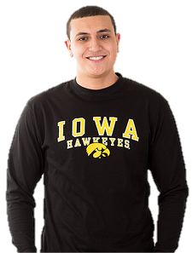
“My job with the university has helped me learn the importance of effective communication and time management.”

Slide 16
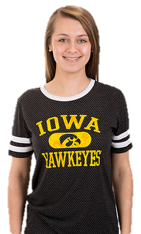
“My job provided me with a sense of belonging. It gave me a place where I was needed, a place where I was accepted, and a place I was expected to be.”

Slide 17
Student Employment as a Retention Strategy
Ultimately, retention is relational work. It’s about our relationship with students, their relationships with each other, and their relationship with the institution.
Retention: Students employed on campus are retained higher rates.
Graduation (4-year & 6-year): Students employed on campus graduate at higher rates.
In the Division of Student Life, participants in IOWA GROW® are retained as UI students at higher rates than those who did not receive the conversations.

Slide 18
Benefits for Supervisors
When students make connections to the workplace, they are more invested.
Invested employees do better work and feel more committed and responsible to you.
These conversations also open the line of communication between you and your employees.

Slide 19
Benefits for Supervisors
“The conversations gave me instant feedback on how the students were coping with balancing both work duties and classes and gave me valuable information on how to help students with any issues they were having. I also found it helpful to see how the students were learning their jobs and relating to other employees in the workplace.”

Slide 20
Benefits for Supervisors
“IOWA GROW ® provides a [medium] for developing a deeper relationship with students beyond the workplace. It allows for supervisors to gain an insight into the difficulties and enjoyments that an average student has as part of the college experience.”

Slide 21
Before the conversation
  Think about what you want your student employees to gain from their work.
  “By May, I hope the students I supervise are able to….” (do more, do better, know more, know better).

Slide 22
Discussion
  What skills would you like your student employees to gain from their work?

Slide 23
Before the conversation
  Decide on one-on-one or group conversations.
  Send out questions ahead of time and let students know you will discuss their responses at your meeting.
  Think about how you can integrate your conversation into any check-ins or one-on-ones with students.

Slide 24
Having the conversation
  Remind students this is an Iowa GROW® conversation and restate the purpose.
  Use the four questions to guide the conversation.
  Take notes to refer to during the next conversation.
  Familiarize yourself with resources, included in your folder, in case students need referrals.

Slide 25
Conversation tips
  Put the questions into your own words.
  Weave the questions into your conversation.
  Use your notes to revisit topics of interest in later conversations.

Slide 26
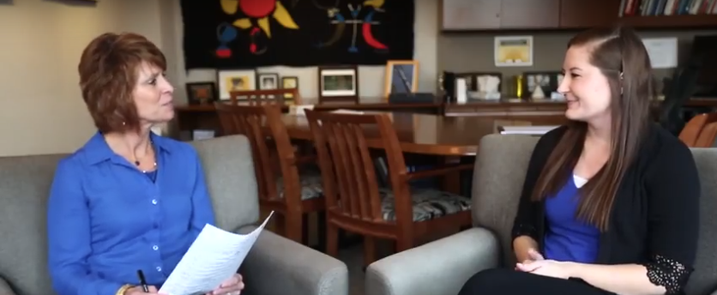
Example conversation
https://vp.studentlife.uiowa.edu/priorities/grow/

Slide 27
Continuing the conversation
  Prompt students regarding the skills you have determined they should be learning.
  Incorporate other questions in addition to the four.
  Ask students to reflect on their experiences since your last conversation.
  Mention at the end of the conversation that you will be discussing this again later in the semester.

Slide 28
Facilitating group meetings
Keep groups at eight students or fewer so that everyone has a chance to speak.
Make sure to provide questions beforehand so that students come ready to discuss.
Encourage students to share with a partner what they are learning at work and how it connects with academics.
After partners have shared, have them report back to the group on what they talked about.

Slide 29
Making Referrals
When a student confides in you about a personal concern, this means they trust you.
As a supervisor, you don’t have to solve the problem for them, but just listen and connect them to a resource that can help.
Familiarize yourself with the list of resources in your folder.

Slide 30
Anticipating challenges
What challenges do you anticipate with incorporating Iowa GROW® into your work?
What strategies might you use to overcome these challenges?

Slide 31
Practice with a partner
Conversation Introduction
4 Guiding Questions
  How is this job fitting in with your academics?
  What are you learning here that’s helping you in school?
  What are you learning in class that you can apply here at work?
  Can you give me a couple of examples of things you’ve learned here that you think you’ll use in your chosen profession?
Conversation Closing

Slide 32
A “learning-centric” environment
Use learning language in position listings.
Add learning-based interview questions.
Talk about learning and Iowa GROW® during onboarding.
Remind students about the purpose of Iowa GROW® during each conversation.
Ask students to set a learning goal each semester.

Slide 33
Resources
Supervisor folders
IOWA GROW® website:
https://vp.studentlife.uiowa.edu/grow

Slide 34
Teri Schnelle, Assistant Director, teri-schnelle@uiowa.edu

