Slide 1
Alcohol-related Ambulance Calls in Johnson County, IA
Kendra Kramer
University of Iowa | College of Public Health

Slide 4
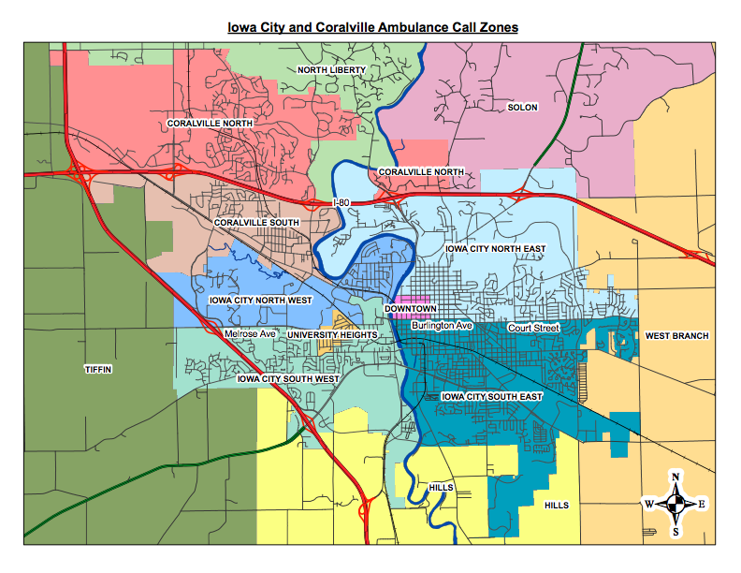
Johnson County Ambulance Call Zones

Slide 6
Rank | Zone | % of total calls
1 | Downtown | 31.8%
2 | SE Quad | 24.8%
3 | NE Quad | 11.9%
4 | Coralville South | 8.5%
5 | SW Quad | 8.4%
6 | Other* | 7.1%
7 | North Liberty | 4.1%
8 | NW Quad | 3.2%
9 | Coralville North | 1.7%
*Other includes: Cedar County intercepts, Coralville fire, Hills, Iowa County, JCAS, Kalona, Lone Tree, Mercy Hospital, Out of County, Oxford, Riverside, Solon, Tiffin, UIHC, University Heights and West Branch calls.

Slide 7
*Other includes: Cedar County intercepts, Coralville fire, Hills, Iowa County, JCAS, Kalona, Lone Tree, Mercy Hospital, Out of County, Oxford, Riverside, Solon, Tiffin, UIHC, University Heights and West Branch calls.

Slide 19
*Data only includes weekends during football season (August – November)

Slide 20
*Data only includes weekends during football season (August – November)

Slide 21
*Data only includes weekends during football season (August – November)

Slide 22
*Time of day data not available for 2012.

Slide 28
Alcohol-Related Ambulance Calls Age Statistics Over time
Zone | Year | Min Age | Max Age | Mean Age | Mode
Downtown | 2008 | 16 | 67 | 25.9 | 19
 | 2009 | 17 | 74 | 28.2 | 19
 | 2010* | 8 | 74 | 33.9 | 20
 | 2011 | 15 | 62 | 27 | 19
 | 2012 | 16 | 52 | 23.5 | 18
 | 2013 | 17 | 72 | 27.3 | 21
 | 2014 | 18 | 114 | 30.9 | 18
 | 2015 | 17 | 69 | 30.7 | 18
SE Quad | 2008 | 18 | 80 | 36.2 | 20
 | 2009 | 18 | 77 | 36 | 21
 | 2010* | 8 | 59 | 32.4 | 20
 | 2011 | 17 | 70 | 38.5 | 52
 | 2012 | 15 | 73 | 37.5 | 21
 | 2013 | 14 | 82 | 39.7 | 50
 | 2014 | 15 | 86 | 41.5 | 53
 | 2015 | 14 | 85 | 39.5 | 54
Zone | Year | Min Age | Max Age | Mean Age | Mode
NE Quad | 2008 | 17 | 85 | 30.9 | 19
 | 2009 | 18 | 62 | 28.2 | 18
 | 2010* | 19 | 62 | 34.8 | 20
 | 2011 | 17 | 67 | 28.6 | 19
 | 2012 | 17 | 66 | 31.7 | 18
 | 2013 | 17 | 73 | 26.5 | 18
 | 2014 | 15 | 75 | 28 | 18
 | 2015 | 17 | 63 | 28.6 | 18
SW Quad | 2008 | 17 | 79 | 35.2 | 18
 | 2009 | 16 | 83 | 31.5 | 18
 | 2010* | Data Not Available
 | 2011 | 18 | 63 | 35.1 | 20
 | 2012 | 18 | 65 | 31.8 | 20
 | 2013 | 17 | 74 | 35.1 | 47
 | 2014 | 18 | 75 | 34 | 19
 | 2015 | 16 | 63 | 32.2 | 18
*Note: 2010 data is from March-December

