Slide 1
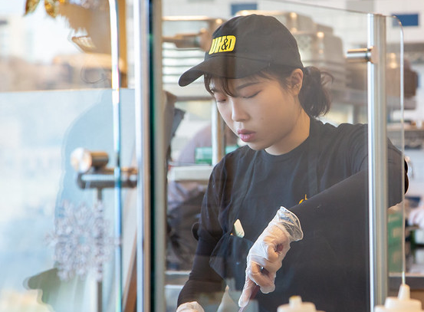
Iowa GROW
Guided Reflection on Work

Slide 2
Student Employment
Sixty percent of UI students work on campus while attending classes, working an average of 11 hours per week.
On an annual basis, over 8,000 students are employed through on-campus part-time hourly positions earning over $25 million.
Students learn transferrable skills (communication, problem-solving, intrapersonal development, interpersonal development), gain civic skills and behaviors, build competence, and increase their openness to others from a variety of backgrounds and cultures (Fede et al., 2018; Barnhardt et al., 2019; Halper et al., 2020; Trolian & Rossman, 2022)

Slide 3
Guided Reflection On Work (GROW)
Iowa GROW uses brief, structured conversations between student employees and their supervisors to make the learning that is occurring through student employment more “visible” to students.
All student employees working in the Division of Student Life participate in Iowa GROW.

Slide 4
4 Key Questions
How is this job fitting with your academics?
What are you learning here at work that’s helping you in school?
What are you learning in class that you can apply here at work?
Can you give me a couple of examples of what you’ve learned here that you think you’ll use in your chosen profession?

Slide 5
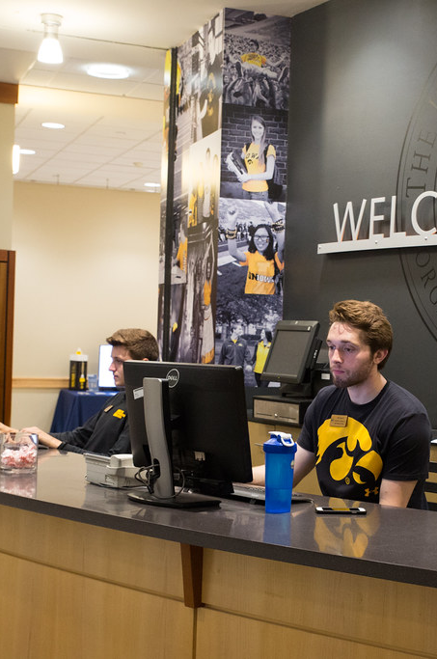
Reflect, Integrate, Apply, & Connect
Think about experiences inside and outside the classroom
Connect what you are learning from different courses, out of class experiences, and life beyond the institution
Transfer and use what you have learned in different settings
Connect the skills you develop to what employers want and need

Slide 6
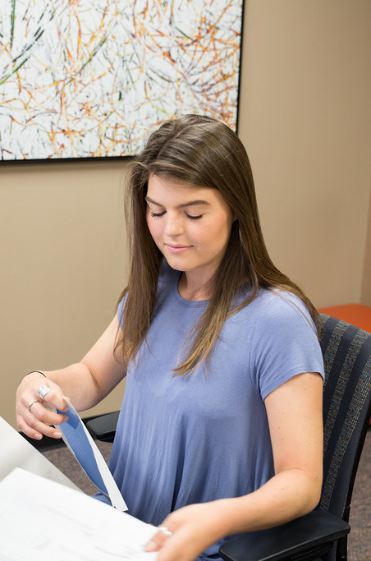
Process
You will have two, brief structured conversations with your supervisor each semester
Small group or 1:1 conversations in a variety of settings
An average conversation takes 5 minutes
There are no wrong answers!

Slide 7
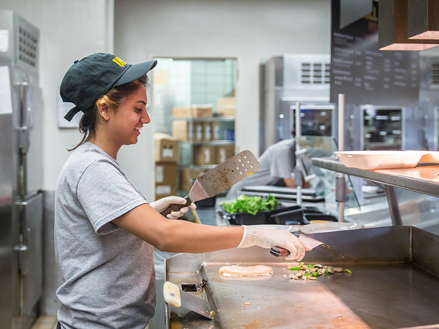
Student Photo

Slide 8
Transferrable Skills in the Workplace
Leadership
Ability to work in a team
Written communication skills
Problem solving skills
Strong work ethic
Verbal communication
You are gaining these skills from employment. BUT unless you have an opportunity to reflect on what you are learning, you won’t be able to effectively articulate this to future employers.

Slide 9
Findings
Iowa GROW® participants are significantly more likely to report the following 10 outcomes of student employment:
1
My supervisor helps me make connections between my work and my life as a student.
6
My job has helped me improve my written communication skills.
2
My job has helped prepare me for the world of full-time employment.
7
My job has helped me improve my verbal communication skills.
3
I can see connections between my job and major/coursework.
8
My job has helped me develop conflict negotiation skills.
4
My job has helped me learn about career options.
9
My job has helped me use critical thinking skills to form opinions and solve problems.
5
My job has helped me develop more effective time management skills.
10
Because of my job, I am able to work effectively with individuals with a variety of backgrounds, experiences, and cultures.

Slide 10

Quote from a Student 1
“It has taught me the responsibility of time management and to apply the knowledge I get from classes to my work. It has also improved my communication as well as personal skills.”

Slide 11
GROW correlates with students having more…
Humanitarian and civic engagement (Halper, 2020)
Critical thinking and problem-solving skills (Halper, 2020)
Practical competence (Halper, 2020)
Self-efficacy (Hansen, 2019)
Desire to do a good job (Hansen, 2019)

Slide 12

Quote from a Student 2
“My job with the university has helped me learn the importance of effective communication and time management.”

Slide 13
Examples of Classroom Connections
Communication Skills
What you learn: Writing essays, giving presentations
On the job: Draft clear emails, explain tasks to coworkers, assist customers professionally
Teamwork & Collaboration
What you learn: Group projects, lab partnerships
On the job: Work with coworkers to solve problems, support team goals
Problem Solving
What you learn: Critical thinking in assignments
On the job: Troubleshoot issues, suggest improvements to processes
Leadership & Initiative
What you learn: Leading class discussions, organizing study groups
On the job: Take initiative on tasks, mentor new student employees

Slide 14
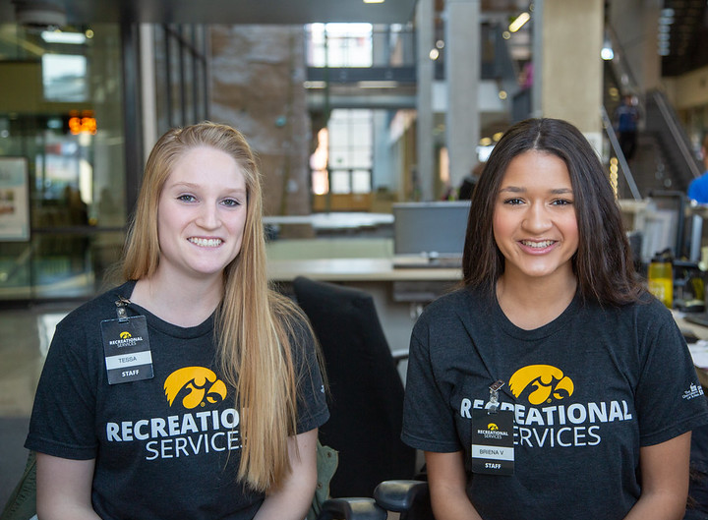
Photo of Two Students

Slide 15
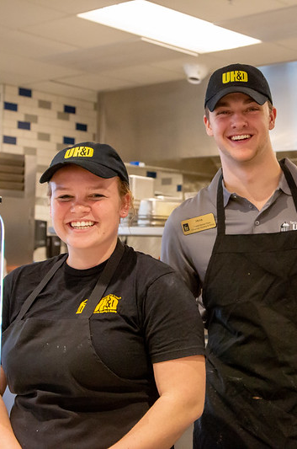
What’s Next
Think about what you hope you learn while working here. Share this with your supervisor!
Think about the connection between what you are learning at work and what you are learning in class.
Connect with additional resources.

Slide 16
Additional Resources
Pomerantz Career Center resume and interview support:
https://careers.uiowa.edu/resumes-cover-letters
https://careers.uiowa.edu/interviews
My Career Path Student Employment Module outlines expectations, workplace etiquette, transferable skills, and goal-setting. https://careers.uiowa.edu/careerpath

Slide 17
Additional Resources Continued
UI STEP Workforce Development Sessions provide professional development and training for student employees that is beyond the job specifics and focuses solely on workforce development and professionalism. https://careers.uiowa.edu/jobs/student-employment/ui-step-workforce-development-sessions
UI Student to Employed Professional (STEP) is a 2-credit hour, full 15-week course. Students will understand what is expected of entry-level employees and graduate school applicants with their resume, interview, and on-the-job performance. https://careers.uiowa.edu/ui-step

Slide 18
Last Slide

